Slide 1


Machine learning for physics and astronomy chapter 5
Viviana Acquaviva

Slide 2
Regression Models

Slide 3
Regression
We talk about regression when the outcome is a continuous variable, instead of a class.
Many classification problems can be solved as regression problems, by using a threshold on the continuous variable.
For example, how could you solve the planet habitability problem as regression?
Which approach is preferable?

Slide 4
Main difference: evaluation
The classification metrics (accuracy, precision, recall…) we have used so far won’t work – why?
We need something that measures how close we are to the correct answer. Ideas?
I will show some examples, but in my experience: easier said than done!

Slide 5
Correlation
Often, we use some kind of correlation analysis to measure the strength of the association between input and output.
Only concerned with strength of the relationship
No causal effect is implied
Problem: the strength of the correlation is difficult to quantify!

Slide 6
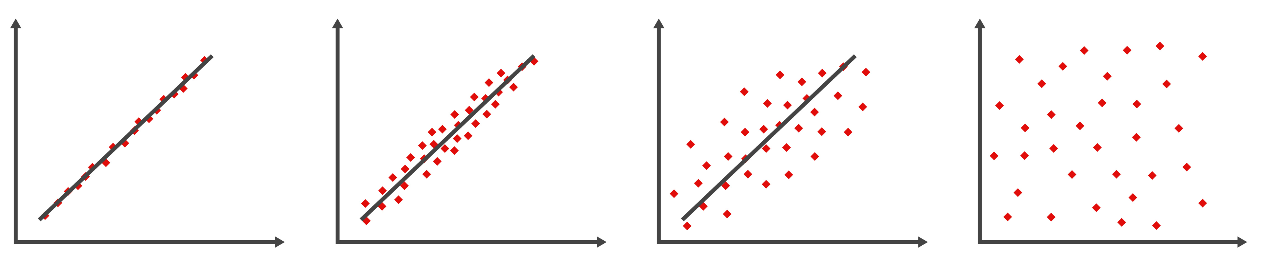
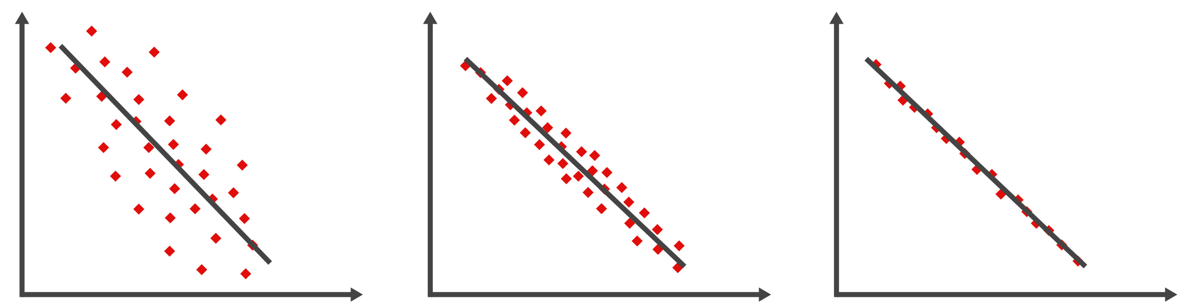
Examples
Notes:
Figures licensed from Adobe Stock.

Slide 7
Regression metrics
How “strong” is relationship between predictors & outcome?
We can attempt to measure the fraction of observed variance of the target variable (“outcome”) that can be explained by the features (”predictors”):
where y_{i} = true values,
the bar denotes the mean, and the hat denotes the prediction.
SST = Sum of Total Squares
SSR = Sum of Squares due to Residuals

Slide 8
Coefficient of Determination R²
How “strong” is relationship between predictors & outcome?
where:
SSR = sum of squares due to residuals
SST = total sum of squares
R² =
1 - SSR/SST
Statistics books will normally tell you that R² is bounded between 0 and 1.
1 indicates perfect correlation, and 0 indicates no relationship
(a model that predicts the mean of true values will have R² = 0).
In machine learning, however,
we build the model using only on the training set.
So R² can be negative on the test set
(e.g., the predictions can be arbitrarily bad, worse than the mean!)

Slide 9
INterpreting the Coefficient of Determination
If R² has a value of 0.6, this means 60% of the variation in the dependent variable (y) is explained by your regression model. The remaining 40% is unexplained.
Unlike the indicators used for classification problems, the coefficient of determination does not have a critical value that enables us to draw conclusions.
The higher the value of R², the better the model fits the data.
R² = 1: Perfect match between the line and the data points.
Interpreting R² = 0.9 is much more complicated. In particular, it does not mean that “predictions are within 10% of the correct value”.

Slide 10
IS R² useless?
Many influential statisticians think so - see famously:
http://www.stat.cmu.edu/~cshalizi/ADAfaEPoV/
One issue is that adding (linearly independent) features always results in better (train) R² – no penalty for overfitting.
Another issue is that – like all measures of correlation – applying a nonlinear coordinate transformation will change R².
My view: When it is used in a machine learning setting (i.e. we look at R² for predictions, on test set), it is a useful tool to compare models.
If features and targets are the same, a model with higher R² score on the predicted values is better.
Note that we can’t distinguish between a poor R² that comes from bad modeling, and a poor R² that comes from noisy data :(

Slide 11
Do we have other metrics?
Many others, of course!
For example, the mean square error, the mean (median) absolute error, the root mean square error.
yes, it’s just the square root
of the MSE; but it is useful
because it gives *typical* deviation
For an unbiased predictive model (mean of residuals vector = 0),
the MSE/RMSE are just the variance/standard deviation of the residuals.

Slide 12
Which one should i use?
I really don’t know.
In many cases, as we have seen, the optimized metric (the loss function that is minimized) is hard-coded into algorithms, so picking a metric is mostly relevant for model comparison (parameter optimization or comparison of different algorithms).
In science, my experience is that MSE/RMSE are often the ones that are easier to interpret.
We can also look at multiple metrics/indicators.
My take-home message is that evaluating regression models is highly non-trivial.

Slide 13
Linear regression
In which we hypothesize that the relationship between independent variable(s), i.e. features, and the outcome, i.e. the target variable, is LINEAR.
Is it machine learning? Is it modeling?
(Is this the real life? Is it just fantasy?)
To create a linear model with a probabilistic interpretation
(i.e., a likelihood), which allows us to do inference on the
parameters, we need several assumptions to hold.

Slide 14
Assumptions of (probabilistic) linear regression
The error variable is normally distributed.
The error variance is constant for all values of x.
The errors are independent of each other.
In machine learning, if you just want to know how well a straight line/hyperplane fits and predict your data, you don’t need to validate those.
HOWEVER, if you believe that your data can be modeled with a linear relationship, you should probably shoot for a probabilistic interpretation!

Slide 15
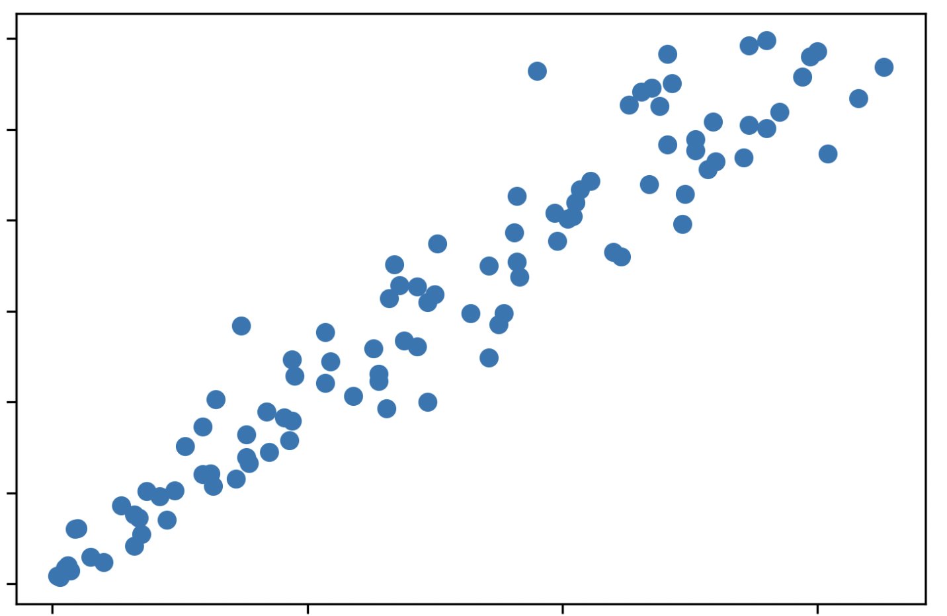
Estimating coefficients

Slide 16
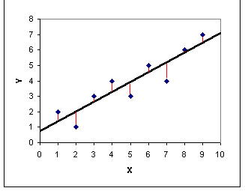
Ordinary least squares
The Least Squares Regression Line is the line that minimizes the sum of the squares of the error
(y – y_{pred})²
Which loss function are we minimizing when we do the OLS fit?
The Mean Square Error
We can re-interpret our fitting procedure in ML “language” as minimizing the MSE loss.

Slide 17
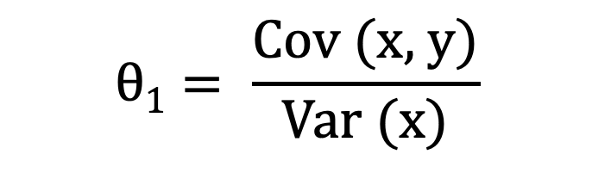

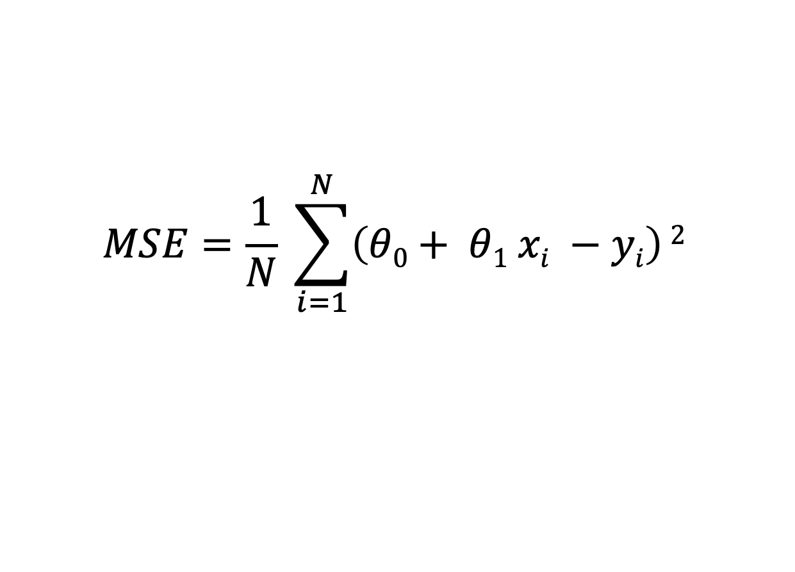
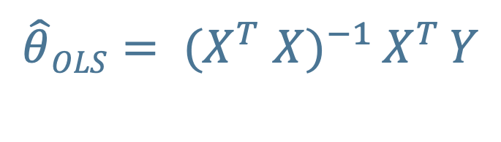
OLS – analytic solution
If we write the MSE for the simple one-dimensional case (fitting a line), we get
$$MSE=\frac{1}{N} \sum_{i=1}^{N}{\left(θ0+ θ1 xi −yi\right)}2$$
Any idea of how to get an analytic solution?
$$θ1= \frac{\text{Cov}\text{ (}\text{x}\text{, }\text{y}\text{)}}{\text{Var}\text{ (}\text{x}\text{)}}$$
$$θ0=\overline{y} − θ1 \overline{x}$$
For the n-dimensional case, the solution is the normal equation:
$\hat{θ}OLS= {(X}^{T}$ ${X)}^{−1 }X^{T }Y$
X = features matrix, Y = obs vector (for train set)
Derivation

Slide 18
Changing metric
What happens if I want to minimize, say, the MAE (Mean Absolute Error)?
1. Will the fit change?
2. Analytic solution?
3. Any idea about implementation?

Slide 19
GRADIENT DESCENT
(smart minimization of loss functions)
The normal equation provides an analytic solution
for the MSE loss only.
Additionally, it requires inverting the matrix
X^{T} · X (what’s its size)?
which is slow when the number of features, m, is large
(typically scales as O(m³) or a little better).
To optimize a different loss function, or speed things up,
it’s useful to have numerical optimization methods in place.
The most popular one is called Gradient Descent.

Slide 20

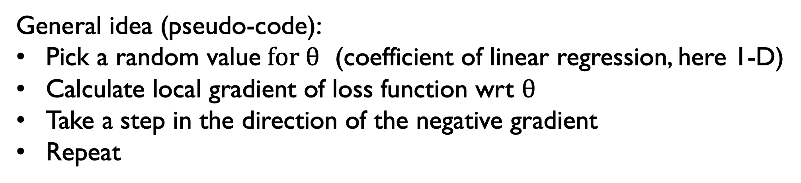
Batch gradient descent
initial value
GD path
argmin(loss)
$$θ$$
General idea (pseudo-code):
Pick a random value$for θ$ (coefficient of linear regression, here 1-D)
Calculate local gradient of loss function wrt $θ$
Take a step in the direction of the negative gradient
Repeat
Questions: will it converge? Under which conditions?

Slide 21


Batch gradient descent
For the MSE loss,
we don’t need to worry about non-convexity,
but choosing a good ”step size” is very important.
steps are too small
steps are too large
$$θ$$
$$θ$$
Other loss functions might not be convex,
and this method might need refinement.

Slide 22
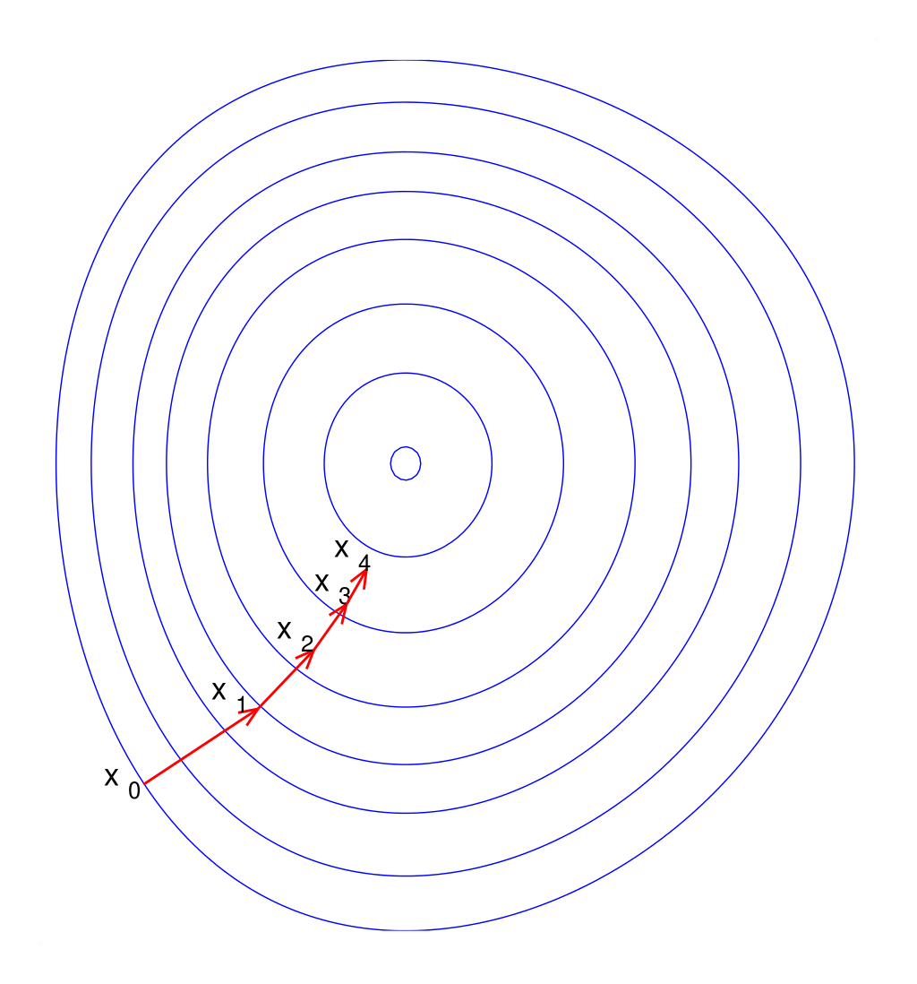
How about scaling? Does it matter?
Yes (for efficiency)!
We need either a feature-dependent learning rate, or (more easily) to scale the feature matrix.
Notes:
This image is from Wikipedia and has a Public Domain license.

Slide 23
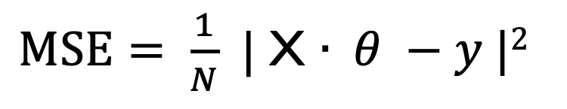
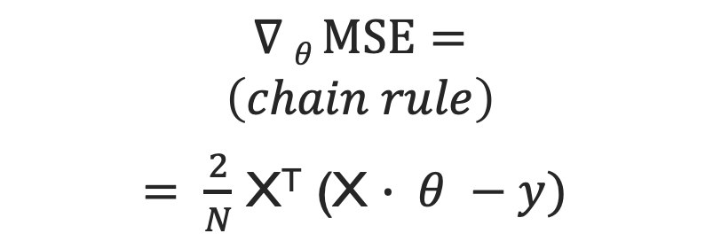
Implementation (MSE loss)
$MSE= \frac{1}{N}$ | X $∙ θ −y |2$
$$∇ θ MSE=$$
$$\left(chain rule\right)$$
$= \frac{2}{N}$ X^{T} (X $∙ θ −y)$
Note that we add a bias term, a "fake" feature = 1, to every instance. This is so we can express the linear model in matrix multiplication form.
Advantages of GD over normal equation for linear model:
No matrix inversion needed
Complexity scaling is now linear with m (# of features),
although it’s not great with N (# of samples) because we calculate
the gradients by summing over the entire learning set

Slide 24
Improvements on “regular” (batch) GD
Stochastic Gradient Descent (compute gradient on only one random example)
Mini-Batch Gradient Descent (compute gradient on a few random examples)
Learning schedule: change learning rate as you get closer to minimum

Slide 25
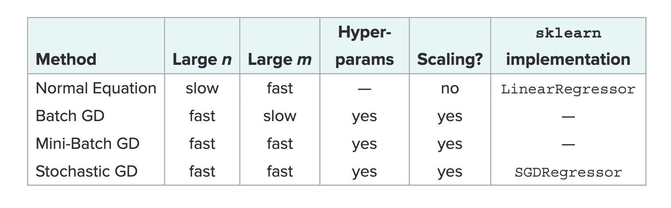
Summary linear regression solvers, MSE LOSS
Note however that the GD methods can all be used for other loss functions;
The only difference is that the gradient computation is not analytical.
Table adapted from Geron, 2019

Slide 26
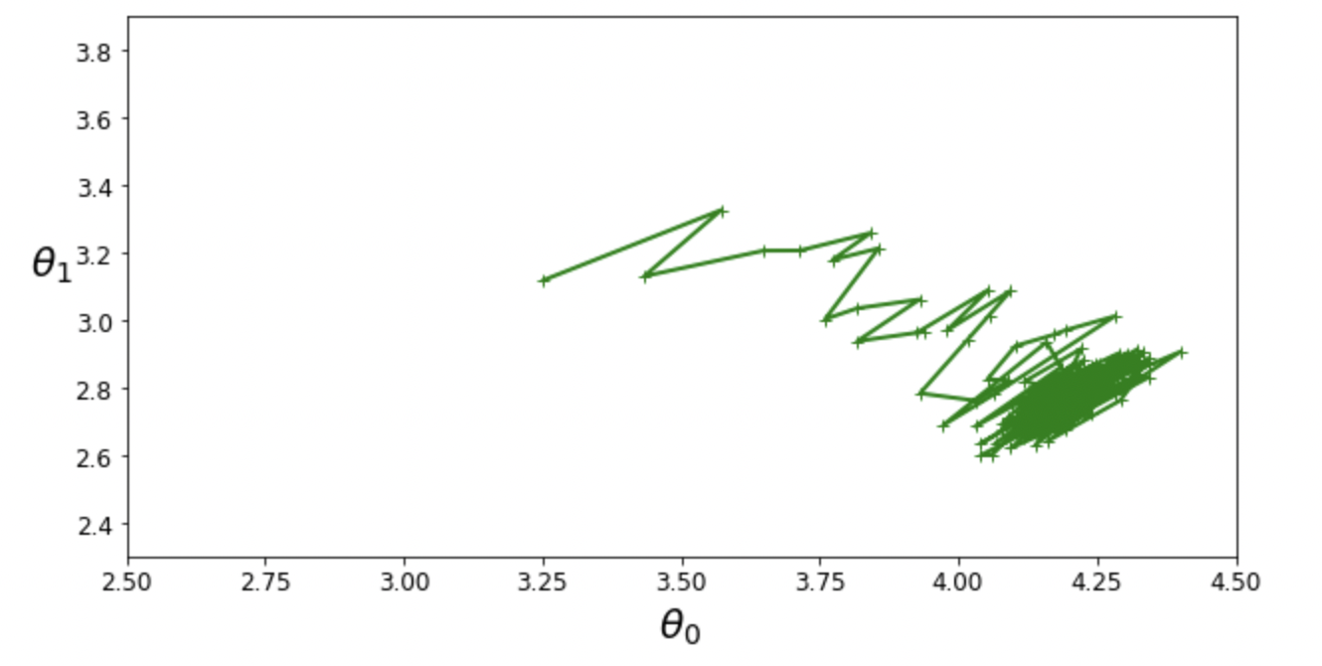
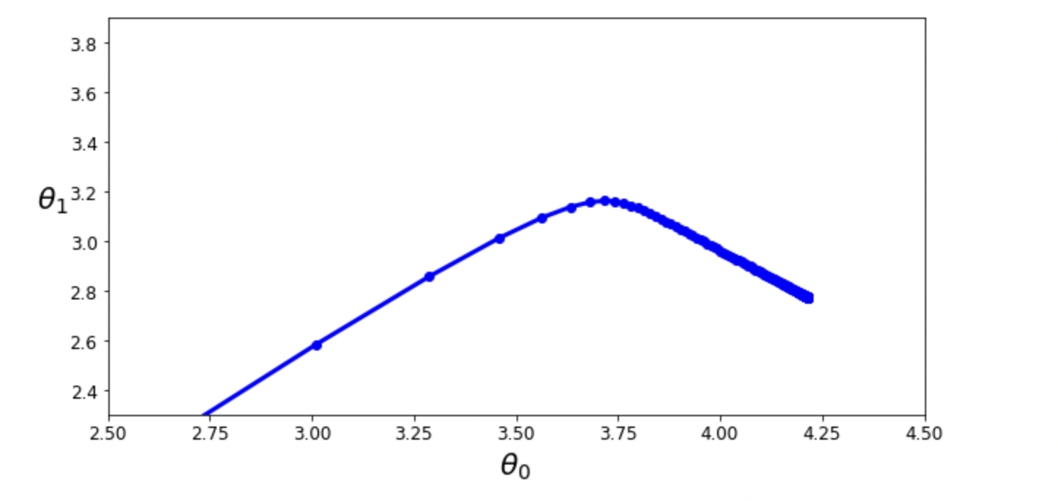
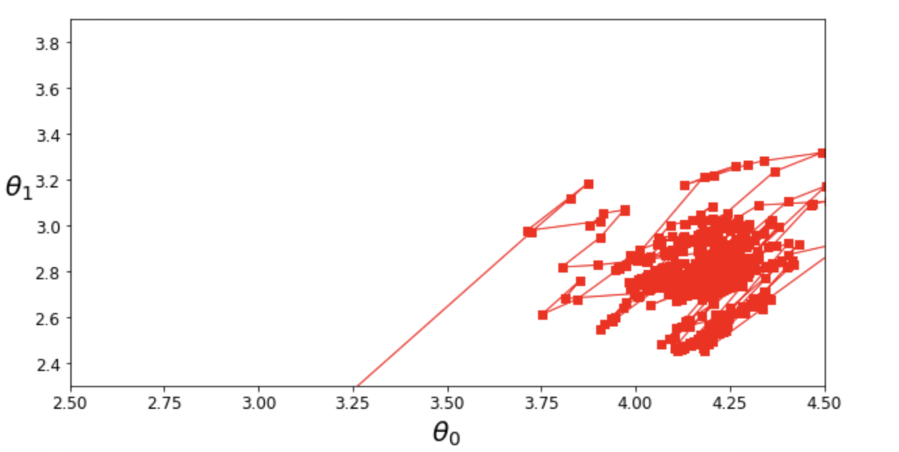
a) Batch GD
b) SGD
c) Mini Batch GD

Slide 27
Regularization for linear models

Slide 28
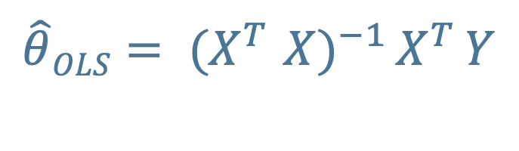
linear models with MSE loss (i.e., ordinary least squares solution) can be solved using the normal equation or some flavor of Gradient Descent.
$\hat{θ}OLS= {(X}^{T}$ ${X)}^{−1 }X^{T }Y$
Here X is the feature matrix, with N (number of objects) rows and m (number of features) columns, to which we have added a “mock” (= 1) feature to write the solution in matrix-multiplication form.
As a reminder, complexity for the normal equation is dominated
by the matrix inversion and scales linearly with # of examples,
but O(m^{2.5-3}) with # of features.
Our main reasons to choose Gradient Descent would be
1. Speed, (for feature-rich data sets) or 2. Using a different loss function.

Slide 29
If the algorithm is overfitting (often this comes from having highly correlated features), it might be helpful to use a regularized solution.
Q: Where have seen regularization in action already?
That’s right, in SVM’s “C” parameter!
One nice bonus of linear models is that we can understand a bit more
of the mathematics behind regularization.

Slide 30
The bias-variance decomposition
Geman 1992 (very famous result)
For the MSE, the test error of a model
(which we use as a proxy for generalization error) can be written as
MSE = bias² + variance + noise
b ⁼ E(y – f(x)) (y = truth; f(x) = prediction)
var = E(f(x) – E(f(x))²)
bias = shift of mean prediction
variance = range of variation of each prediction around the true value
noise = irreducible and model independent

Slide 31

The bias-variance decomposition
MSE = bias² + variance + noise
A lot of optimization techniques in ML are based on
the concept of “trade-off”: we can obtain a lower
test error by shifting around the bias/variance balance,
which is often interpreted in terms of model complexity.
Figure from
Fortmann-Roe
2012

Slide 32
The bias-variance decomposition: consequences for linear models
For linear models, for some weak conditions
(if the errors in the linear regression model are uncorrelated, have equal variances and expectation value of zero),
Gauss-Markov theorem tells us:
1) The normal equation solution (OLS) is unbiased (bias = 0!)
2) The normal equation solution is the optimal unbiased estimator
(i.e., it has the lowest variance among the unbiased estimators)
Does this make it the estimator with the lowest test error?
Nope, and that’s why regularization might be worth it.

Slide 33
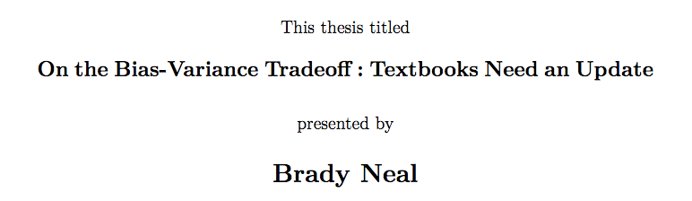
Actually, the concept of bias-variance trade-off
(not decomposition) might be in trouble.
https://arxiv.org/pdf/1912.08286.pdf
Main conclusion: the tradeoff
(namely, the common wisdom that variance
increases with model complexity)
does not seem to be true for neural networks
when the number of parameters increases.

Slide 34
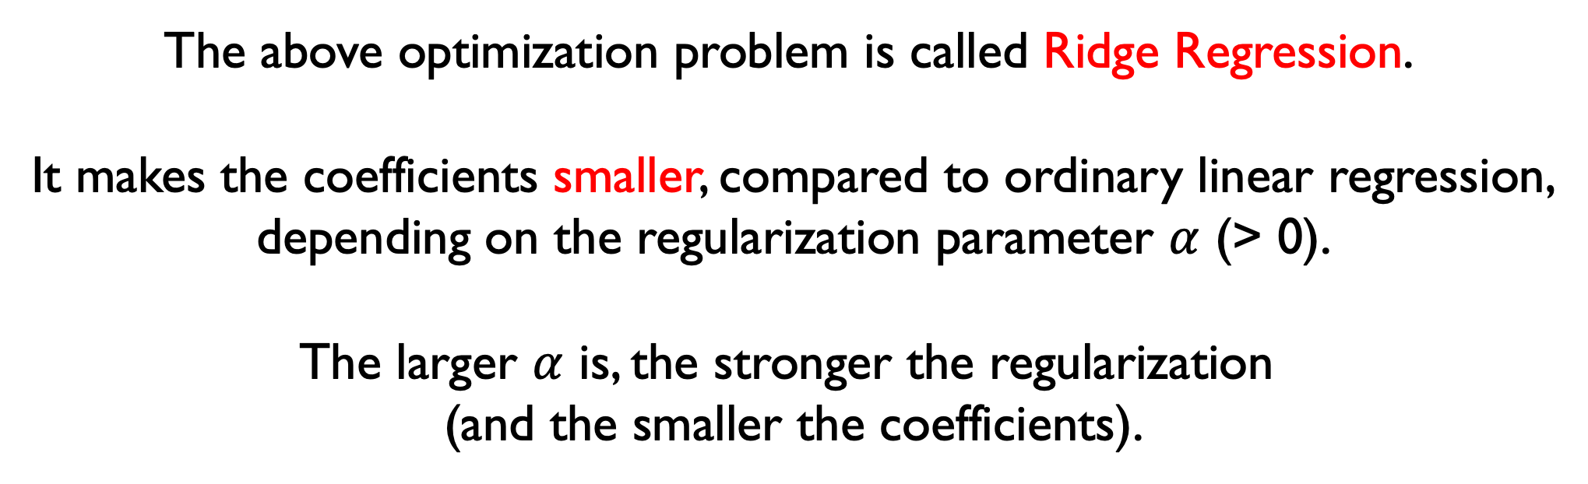
Ok, now back to regularization for linear models.
Will a regularized model be more or less biased than OLS?
More. We are adding bias but hoping to reduce variance
(which is ok even according to Gauss-Markov theorem).
Main idea:
minimize
modified loss function
$$\underset{θ}{argmin}{ \left[\left(X ∙θ −y\right)2+ α \sum_{i=1}^{m}{θ_{i}^{2}}\right]}$$
The above optimization problem is called Ridge Regression.
It makes the coefficients smaller, compared to ordinary linear regression,
depending on the regularization parameter $α$ (> 0).
The larger $α$ is, the stronger the regularization
(and the smaller the coefficients).

Slide 35
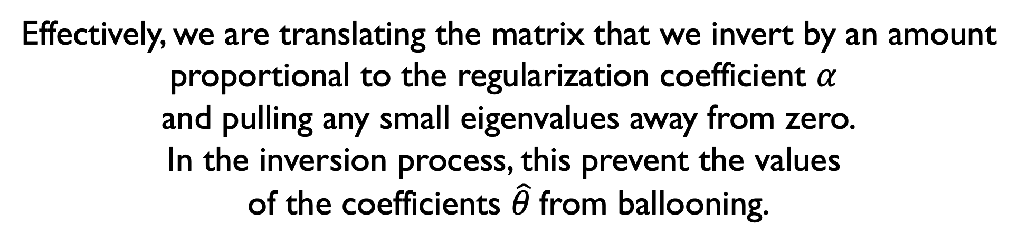
Ridge Regression still has an analytic solution!
$$\underset{θ}{argmin}{ \left[\left(X ∙θ −y\right)2+ α\sum_{i=1}^{m}{θ_{i}^{2}}\right]}$$
has solution
$\hat{θ}RIDGE= {(X}^{T}$ ${X+α I)}^{−1 }X^{T }Y$
Effectively, we are translating the matrix that we invert by an amount
proportional to the regularization coefficient $α$
and pulling any small eigenvalues away from zero.
In the inversion process, this prevent the values
of the coefficients $\hat{θ}$from ballooning.

Slide 36
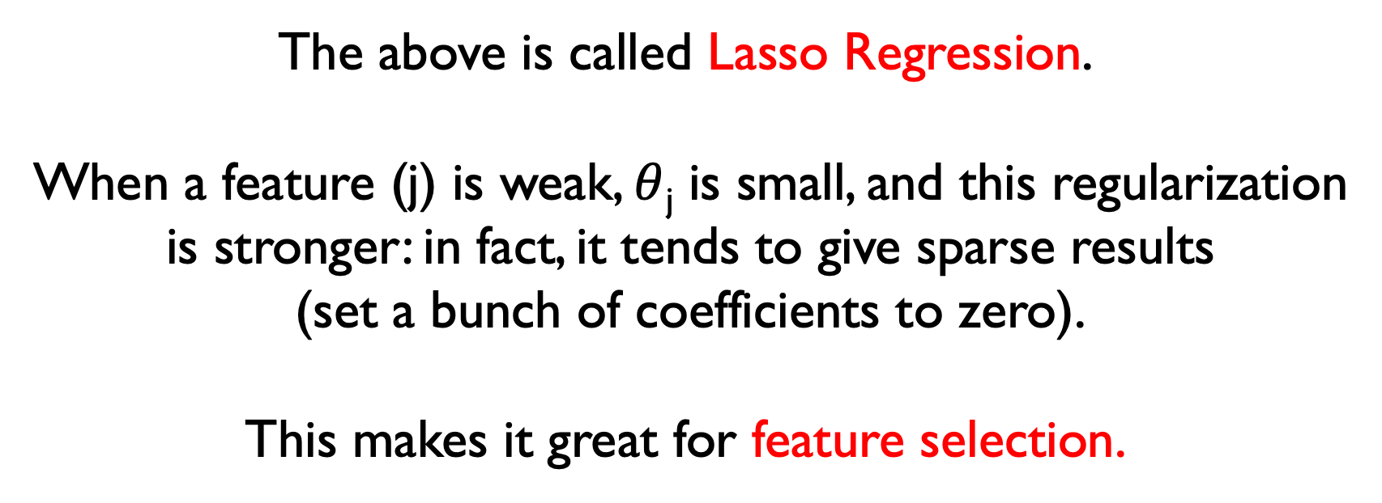
Another form of regularization for linear models
minimize
modified loss function
$$\underset{θ}{argmin}{ \left[\left(X ∙θ −y\right)2+ α\sum_{i=1}^{m}{\left|θi\right|}\right]}$$
The above is called Lasso Regression.
When a feature (j) is weak, $θ$_{j} is small, and this regularization
is stronger: in fact, it tends to give sparse results
(set a bunch of coefficients to zero).
This makes it great for feature selection.

Slide 37
Generalization of linear models
Some image credits: Stanford NLP group

Slide 38
One nice thing about linear models is that they
are simple, efficient, and interpretable.
They can also extrapolate outside the training domain
(compare e.g. with Decision Trees)
It’s nice to be able to re-use the machinery!
We can look at two modifications:
LOGISTIC regression
and POLYNOMIAL regression

Slide 39
Logistic Regression
There are many case studies for which the range of the dependent variable is finite.
The linear models can’t reproduce this behavior.
In Logistic Regression (and many generalized linear models),
we apply a transformation to the dependent variable before applying the linear model.

Slide 40
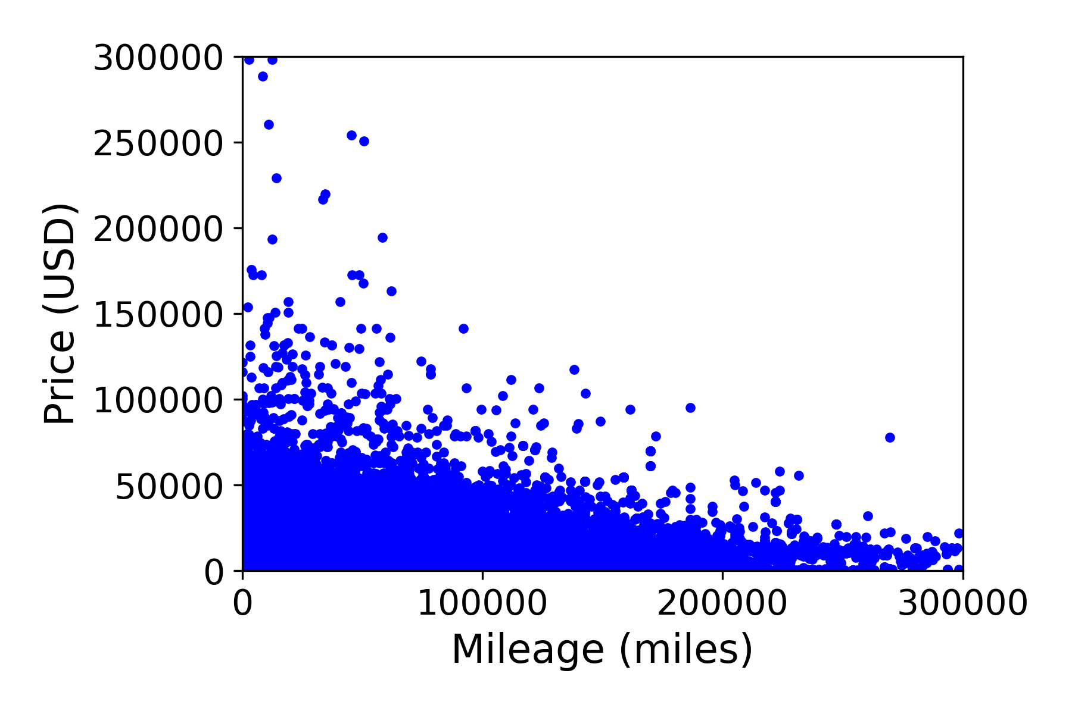
Simple example: USED Cars value
Data available from Kaggle

Slide 41
FIT with a linear model
B₀ = 23,102
B₁ = -0.07
How much is a car with 100,000 miles worth?
$16.074
How much is a car with 400,000 miles worth?
-$5,011

Slide 42
FIT with a modified linear model
Logging our prices, we can refit our model
(i.e. log(Y) = B₀ + B₁ * X) Y = e ^{B0 + B1 * X}
B₀ = 9.4
B₁ = - 4.53 x 10⁻⁶
How much is a car with 100,000 miles worth?
$7,743
How much is a car with 400,000 miles worth?
$1,988

Slide 43
Logistic Regression
A common application, binary logistic regression, is usually meant to solve a classification-like problem where we want to go beyond the 0/1 output.
For example: voting data.
In this case, a type of regression analysis where the dependent variable is class-like: coded 0 (did not happen) or 1 (did happen)
But maybe we want to model the probability (actually, the odds ratio) that someone will vote, using these data.

Slide 44
Logistic Regression
The "logit" model solves these problems: we can model the relationship between the log of the odds ratio and the independent variable with a linear model ln[p/(1-p)] = β₀ + β₁X (2D model; otherwise, X ∙ β)
p is the probability that the event Y occurs, p(Y=1)
[range=0 to 1]
p/(1-p) is the "odds ratio"
[range=0 to ∞]
ln[p/(1-p)]: log odds ratio, or "logit” (logistic unit)
[range=-∞ to +∞]

Slide 45
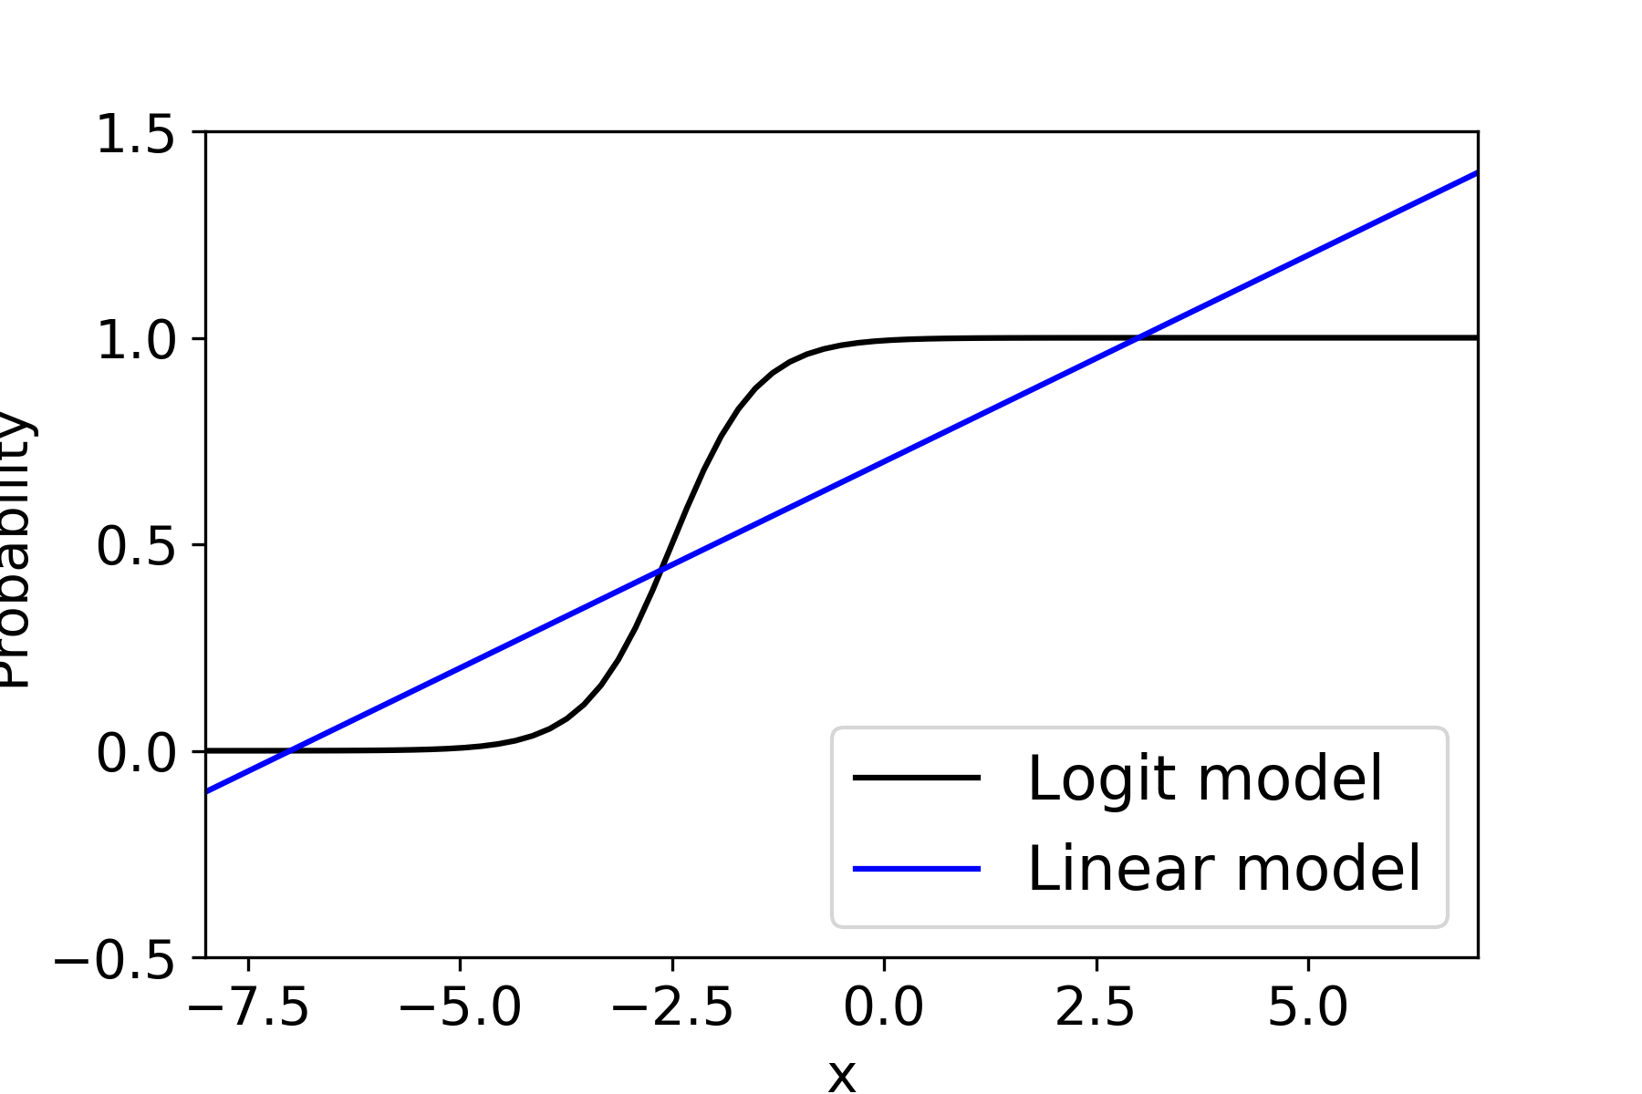
Logistic Regression
In many cases, it is beneficial to keep the range
of the outcome variable limited to (0,1) or any other range.

Slide 46
Of course, not all models where the output is a probability
can be successfully modeled by logistic regression.
There is a strong modeling assumption
(the log odds can be modeled using a linear model).
However, these functions are important because
are examples of SIGMOIDS (s-shaped functions!)
Those are common as activation functions/elements for neural networks.

Slide 47
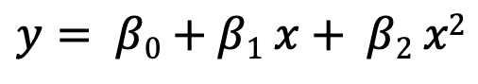
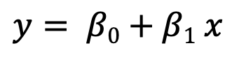
Polynomial Regression as a linear model
y
y
Is the one
on the right
a
linear model?
x
x
$$y= β0+β1 x$$
$$y= β0+β1 x+ β2 x2$$
Yes! A linear model is linear in the coefficients, not the features.
If we are willing to build those features, we can re-utilize the machinery
of linear model in a much wider range of cases.
This can be inspiring for feature engineering + regularization!
Visualization inspired by: https://medium.com/analytics-vidhya/understanding-polynomial-regression-5ac25b970e18

Slide 48
References/further reading
This book (Elements of Statistical Learning) is really good/classic,
free, and it has the derivation of MSE decomposition:
https://web.stanford.edu/~hastie/ElemStatLearn/
Geman et al’s seminal paper:
http://www.dam.brown.edu/people/geman/Homepage/Essays%20and%20ideas%20about%20neurobiology/bias-variance.pdf
Link to Brady Neal’s thesis work:
https://www.bradyneal.com/bias-variance-tradeoff-textbooks-update
Hogg and Villar’s recent work on linear models with many parameters:
https://arxiv.org/pdf/2101.07256.pdf

